Slide 1
Force Field Optimization Using Machine Learning Algorithms
Mohammad Rahimi
6/23/2016

Slide 2

What can we see with the most powerful microscopes?
Notes:
Maximum magnification

Slide 3
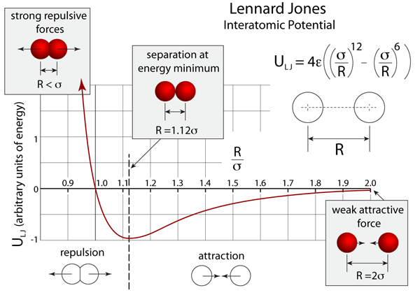
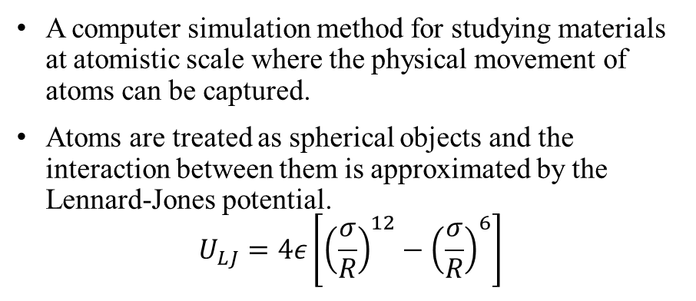

Molecular dynamics simulation
A computer simulation method for studying materials at atomistic scale where the physical movement of atoms can be captured.
Atoms are treated as spherical objects and the interaction between them is approximated by the Lennard-Jones potential.
$$U_{LJ}=4ε\left[{\left(\frac{σ}{R}\right)}^{12}−{\left(\frac{σ}{R}\right)}^{6}\right]$$
$$σ, ε$$
Molecular dynamics
Position
Velocity
Statistical Physics
Physical
properties
Experiment
The procedure to determine LJ parameters which reproduce experimental data is so-called force field optimization.
The trial and error approach is mostly used to optimize force field which is very demanding and expensive.

Slide 4

Molecular dynamics simulation
A computer simulation method for studying materials at atomistic scale where the physical movement of atoms can be captured.
Atoms are treated as spherical objects and the interaction between them is approximated by the Lennard-Jones potential.
$$U_{LJ}=4ε\left[{\left(\frac{σ}{R}\right)}^{12}−{\left(\frac{σ}{R}\right)}^{6}\right]$$
Function
$$σ, ε$$
Molecular dynamics
Position
Velocity
Statistical Physics
Physical
properties
Experiment
$$σ, ε$$
Function
Physical
properties
Experiment
Machine learning algorithms can determine the relationship between the LJ parameters and physical properties and predict the LJ parameter given physical properties
Notes:
Force field refers to the functional form and parameter sets used to calculate the potential energy

Slide 5
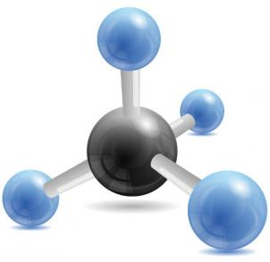
Phosphate
Phosphate is a kind of salt that consists of one central phosphorus atom surrounded by four oxygen atoms.
Calcium phosphates are found in many living organisms, e.g., bone mineral and tooth enamel.
Phosphate has two types of atoms and four LJ parameters need to be optimized.
P
O
Data set
Used the force field developed for pure phosphorus and oxygen as an initial guess
Employed grid search method to define sets of LJ parameters
Performed MD simulation to calculate physical properties
Features | Description
a, b, c | Unit cell vectors
Gamma | Angle between a and b
Density | Mass / Volume
Cleavage | Energy needs to break the salt
Interface | Energy gain in contact with water
Solvation | Energy gain to solve the salt into water
 | MIN | MAX | Resolution
SigO | 3.0 | 4.0 | 0.1
EpsiO | 0.07 | 0.17 | 0.02
SigP | 3.8 | 4.8 | 0.1
EpsiP | 0.2 | 0.3 | 0.02

Slide 6
Problem Statement
Using machine learning algorithm to optimize force field for phosphate
Predict accurate LJ parameters to reproduce experimental data
Reduce the computational time
Supervised learning problem, more specifically a regression problem
Multiple target variables
SigO, EpsiO, SigP, and EpsiP
Regressor variables
A, b, c, gamma, Density, Cleavage, Interface, Solvation
Regression models
Linear regression, Ridge, Lasso, Random Forest, and GBR
Metric
R² describes the proportion of the variance in the target variable that is predictable from the independent variable.

Slide 7
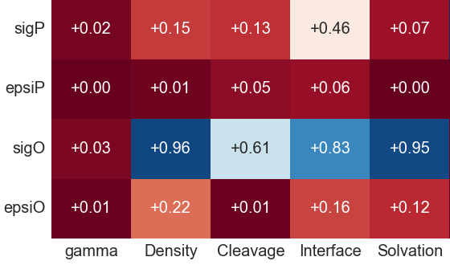
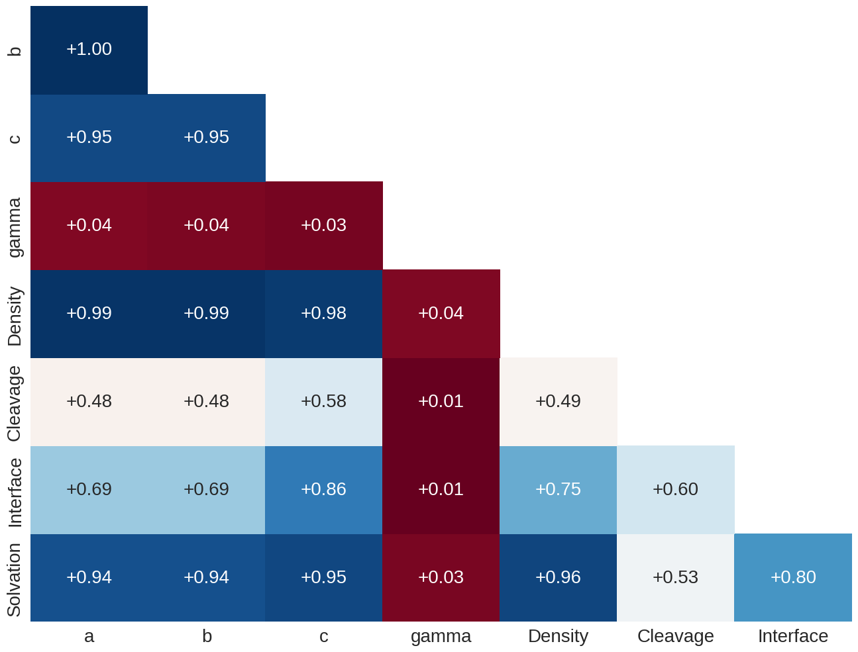
Correlation
Variables a, b, and c are highly correlated with density

Slide 8
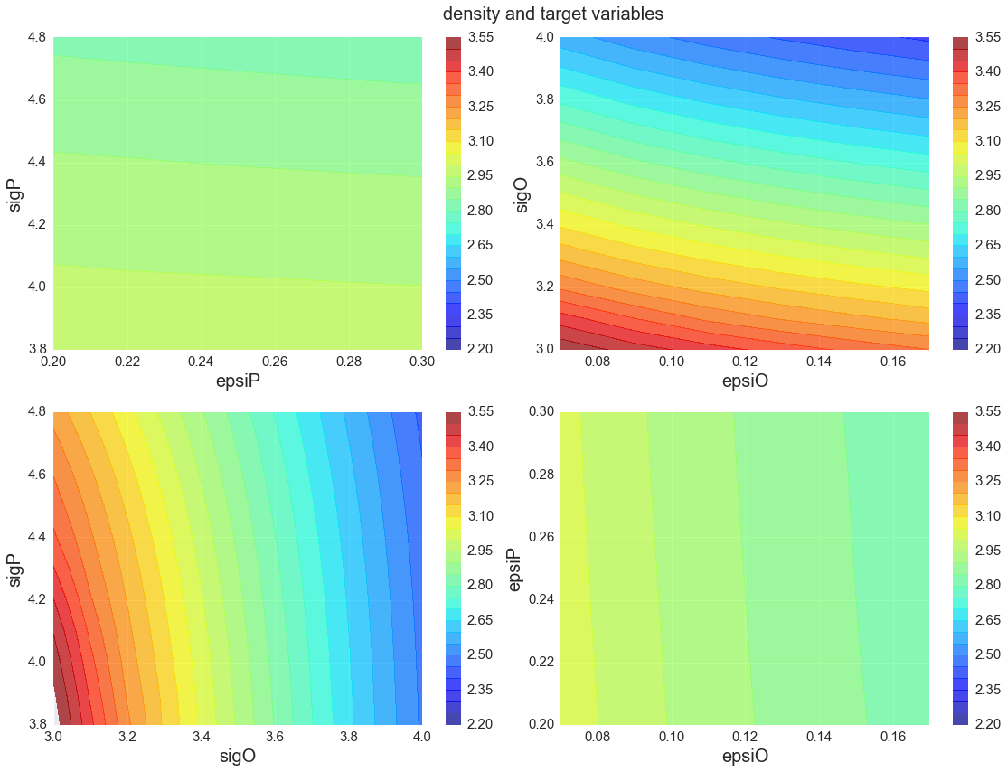
Visualize the relationship between target variables and a regressor variable (density)

Slide 9
Protocol to develop the prediction model
Dataset
(4356 rows)
scikit-learn:
Linear regression
Ridge
Lasso
ElasticNet
Random Forest
GBR
Testing data
(436 rows)
Training data
(3920 rows)
Optimization
Gird search
Improve CV score
R² metric
ML algorithms
Evaluation
Best models

Slide 10
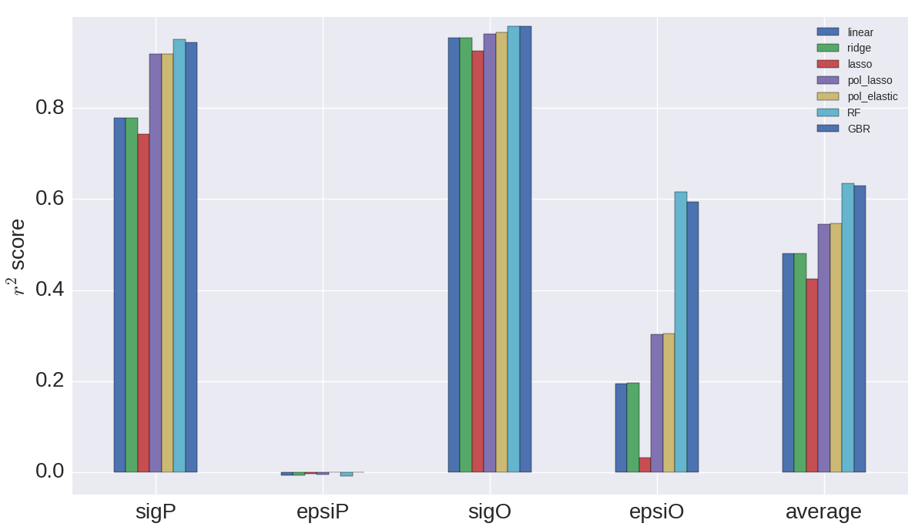
Performance

Slide 11
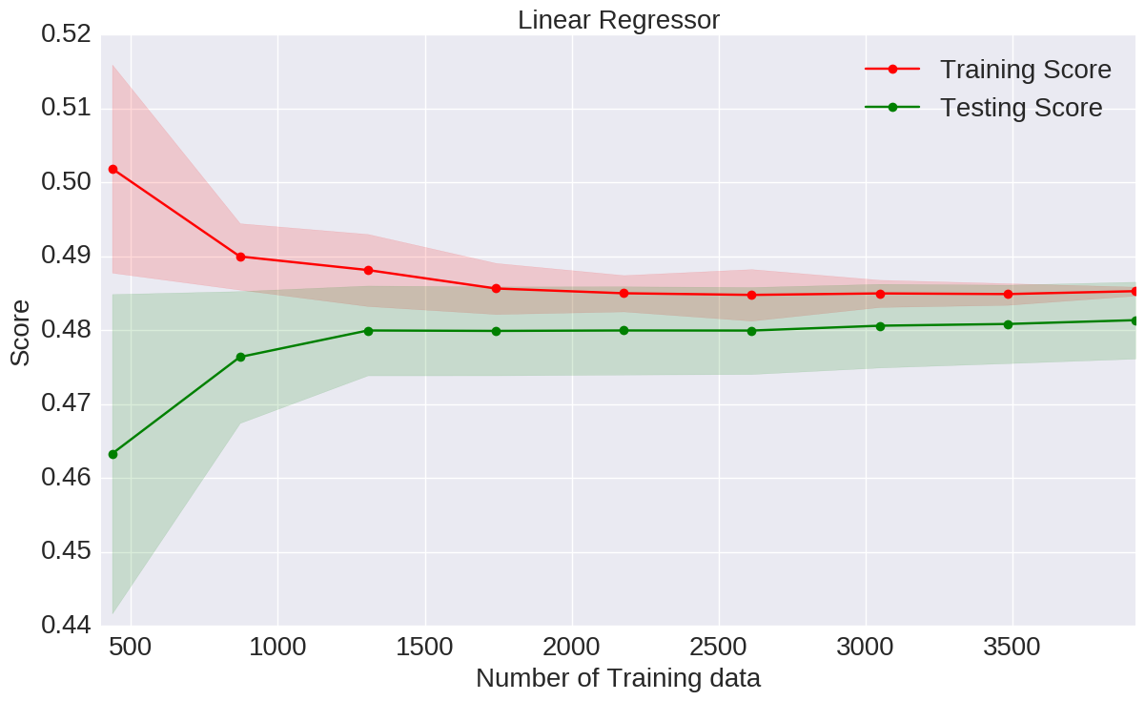
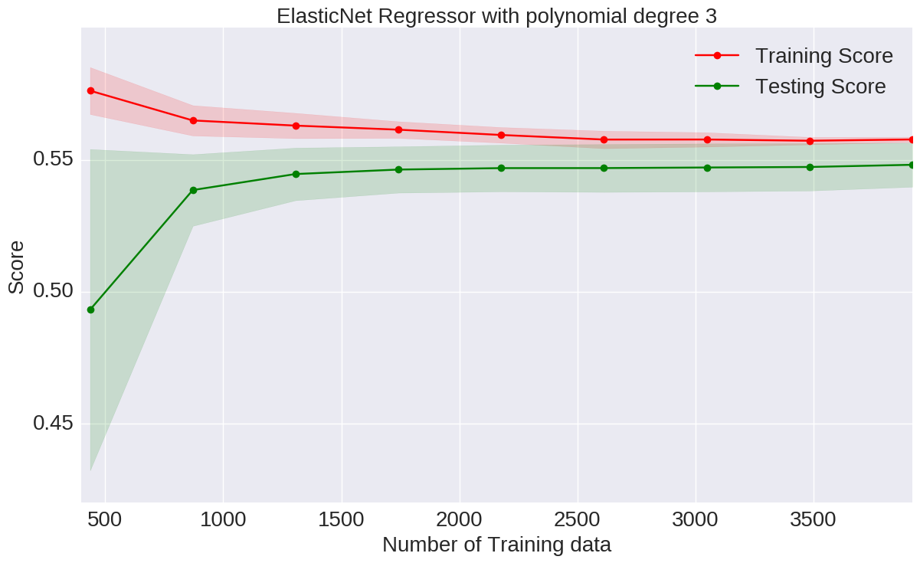
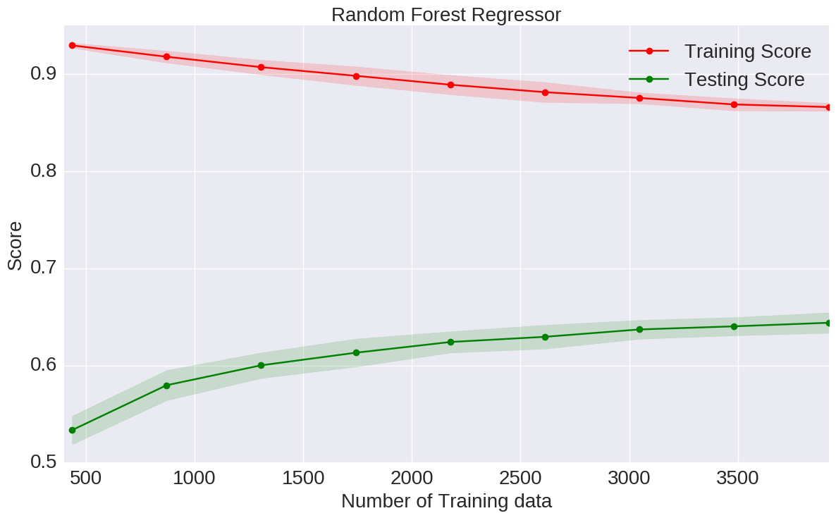
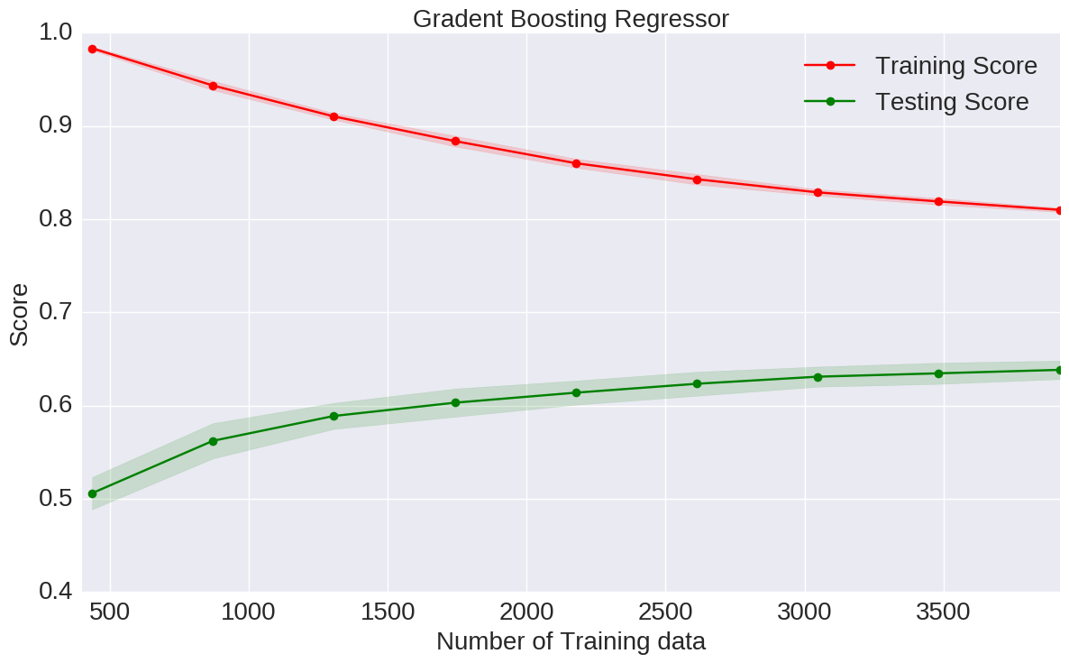
Learning curves

Slide 12
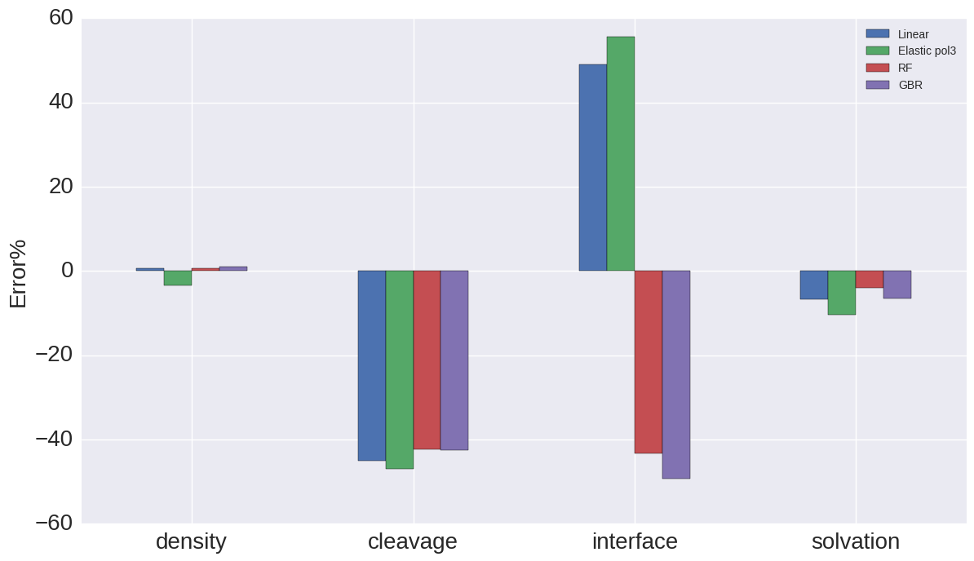

Predict LJ Parameters from Experimental measurement
The realistic data obtained from experimental measurement were used as a set of independent variables to predict LJ parameters, and then MD simulations were performed with the predicted parameters. The accuracy of MD simulation against experiment data were evaluated.
$Error= \frac{experiment−MD simulation}{experiment}×100$
Notes:
In order to justify whether developed models are able to predict the MD parameters, we feed the experimental measurements to the trained prediction models.

Slide 13
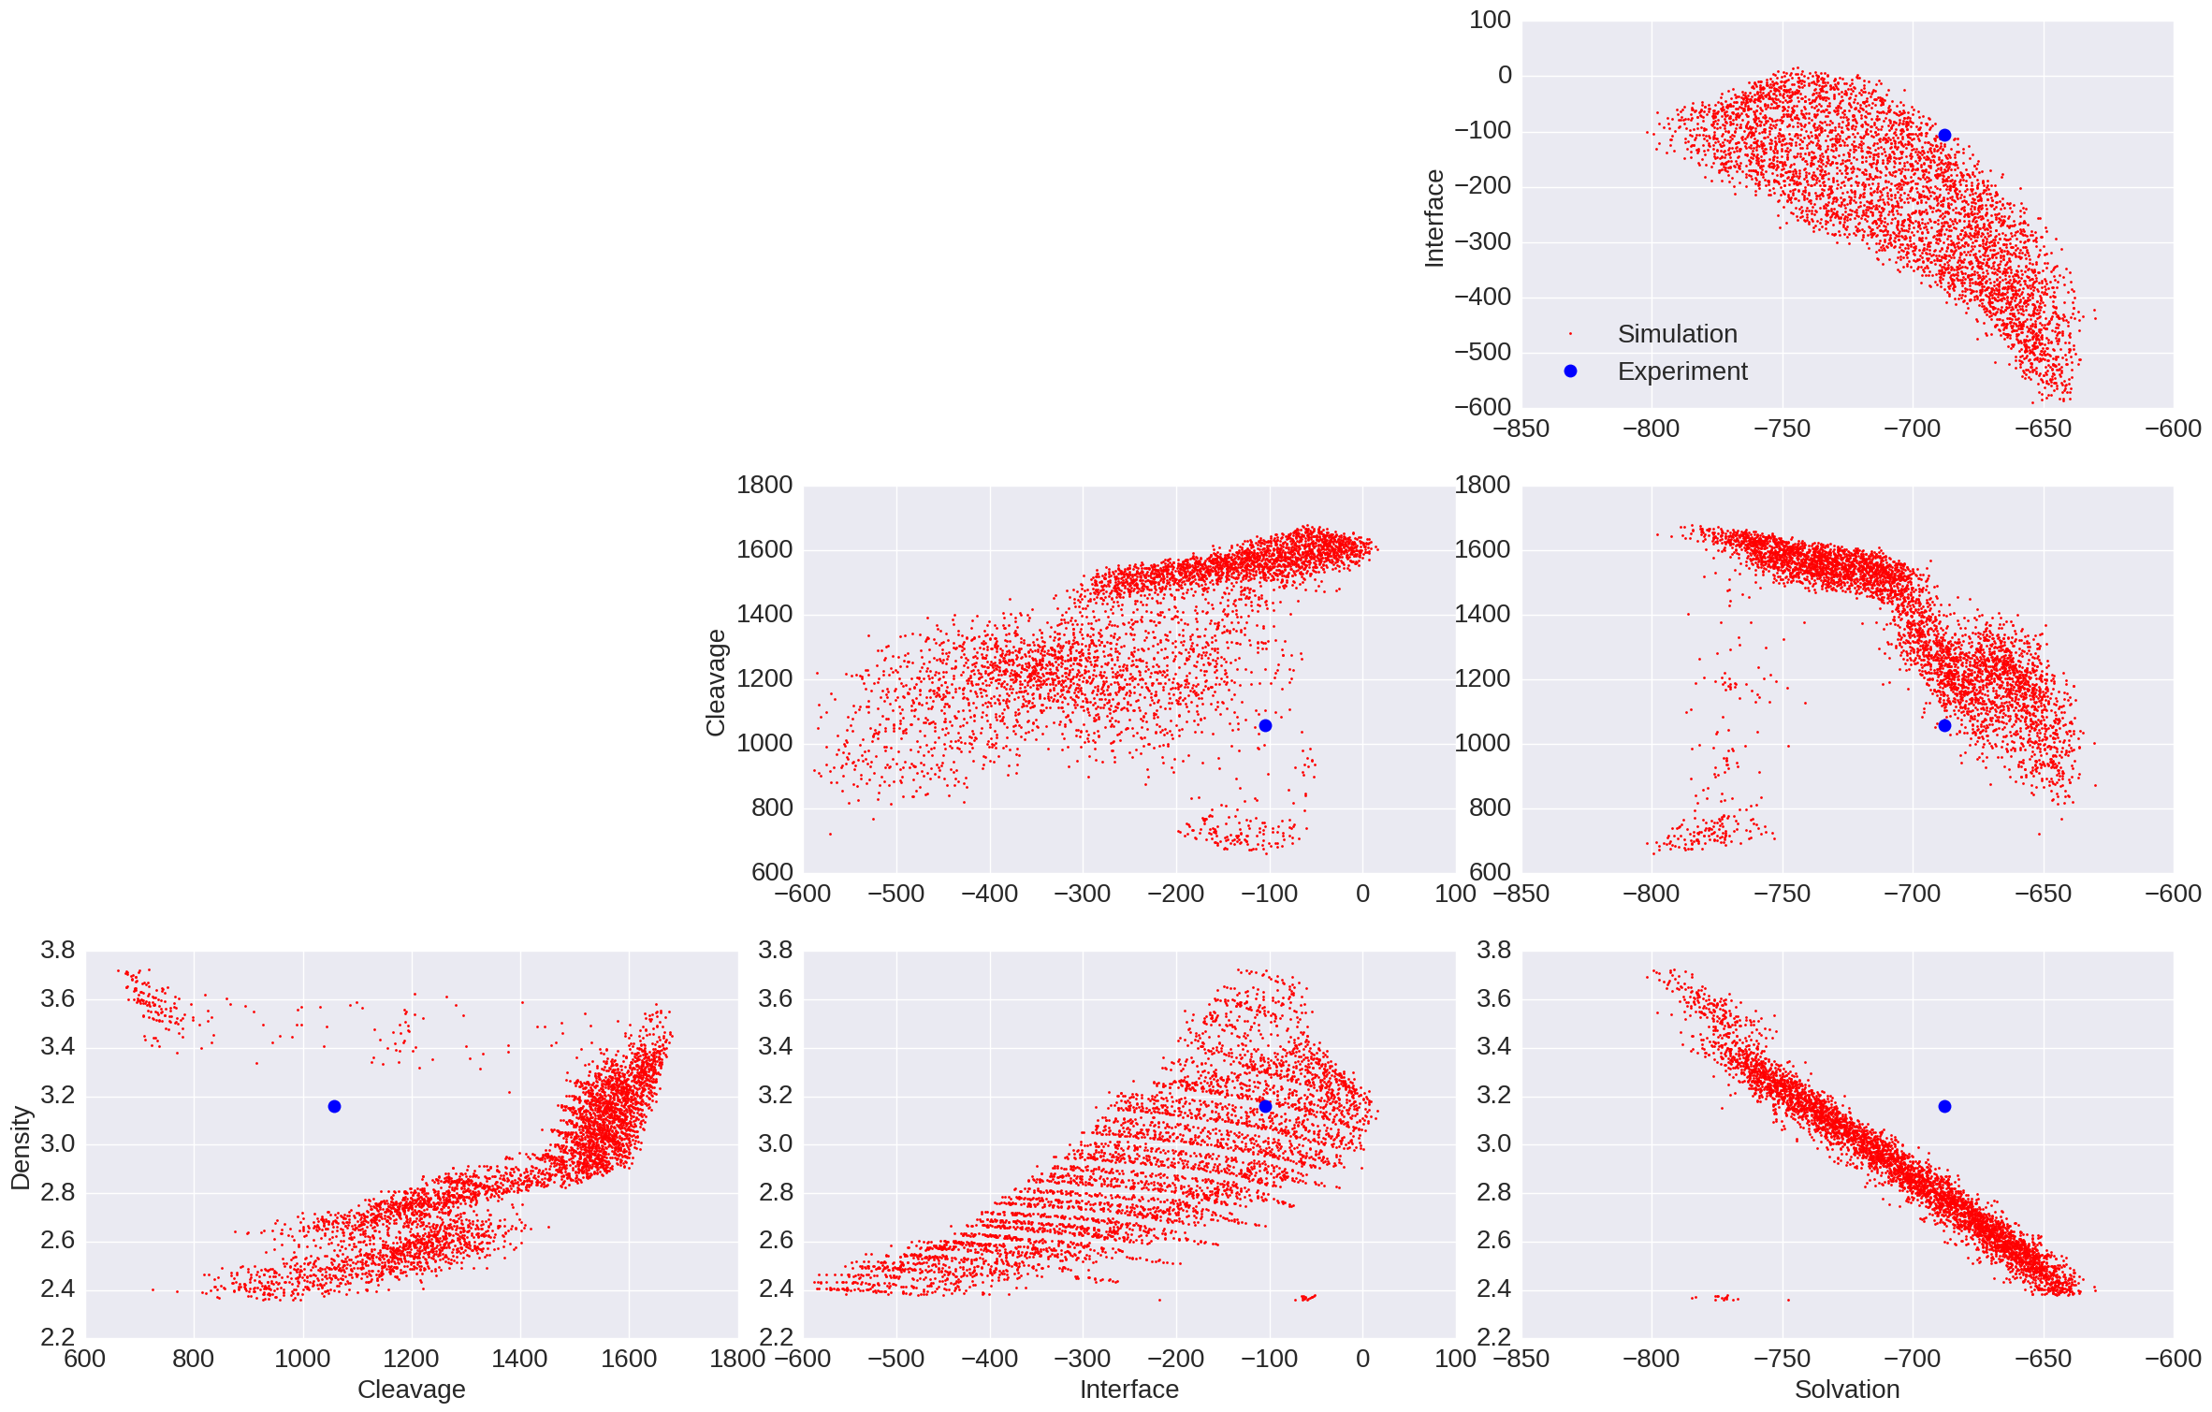
Experiment vs Simulation
Error in experimental measurements
Simple LJ potential cannot describe accurately the interaction of two atoms

Slide 14
Improvement
Calculate new physical properties (add new variables)
Increase the number of data for tree-based models
Ensemble of different kinds of regressor
Conclusion
Developed predictive models to optimize force field for Calcium Phosphate
Realized the relationship between LJ parameters and physical properties for molecules with chemical structure similar to phosphate
Characterized the linear regression as the best model for phosphate
Future plan
Develop predictive models for different molecules with different chemical structure
Built a bank of data for different molecules to reduce the computational time for optimizing force field

Slide 15
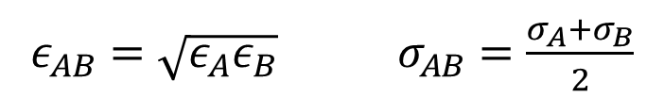
Why are force field optimizations computationally intensive?
A typical MD simulation (e.g. 100,000 atoms over 100 ns) can take several days to complete on a standard HPC node.
Computes the forces on all atoms
Numerically solve Newton’s laws of motions
Number of LJ parameters increases by adding dissimilar atoms
Similar interactions: A-A, B-B
Dissimilar interaction: A-B
B
Mixing rules:
A
A
$ε_{AB}=\sqrt{ε_{A}ε_{B}}$ $σ_{AB}=\frac{σ_{A}+σ_{B}}{2}$
B
A
The mixing rules reduce the number of LJ parameters. However, it can affect the outcome of the simulation, and it is necessary to optimize force field for different mixtures.

Slide 16
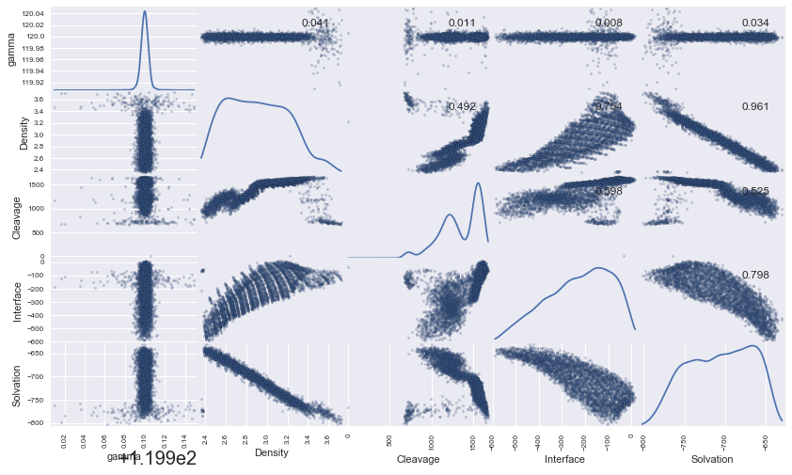

Slide 17
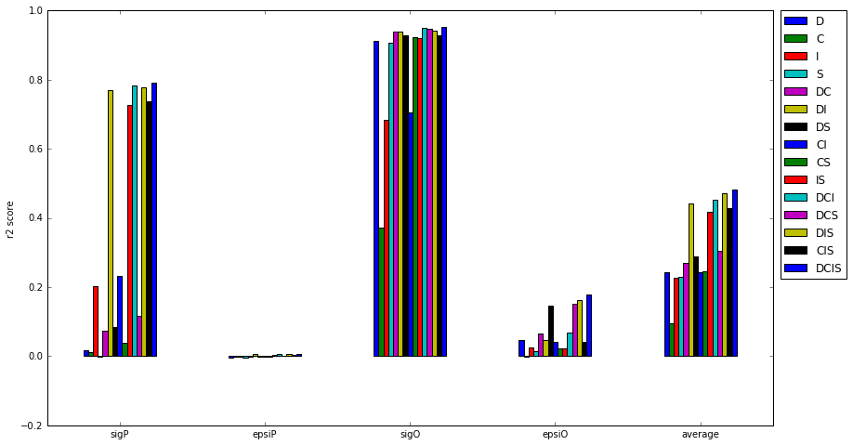

Slide 18
